Slide 1
Week 4 Summary Presentation
“Unified Path Following Guidance For Hybrid VTOLs”
Junwoo Hwang
19.12.2022, Monday

Slide 2
Goals for Week 4
Air-velocity reference vector based path following
Differences in control of multicopter / fixed-wing in Path-following
Different ramp-in/ramp-out function to derive air-velocity reference vector

Slide 3
Goals for Week 4
Air-velocity reference vector based path following
Differences in control of multicopter / fixed-wing in Path-following
Different ramp-in/ramp-out function to derive air-velocity reference vector

Slide 4
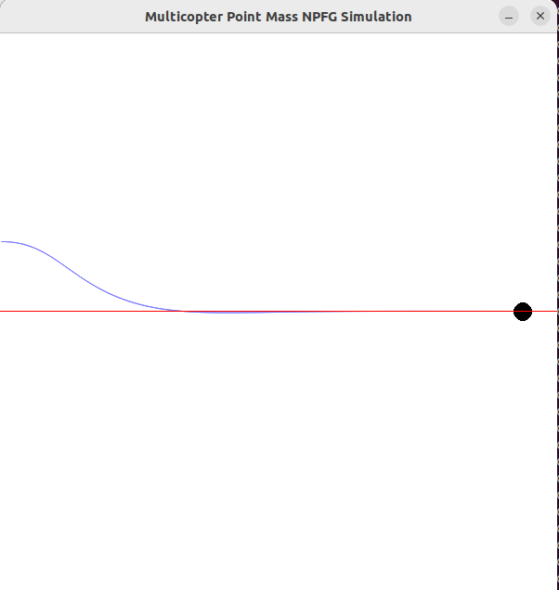
Multicopter Point-mass model

Slide 5
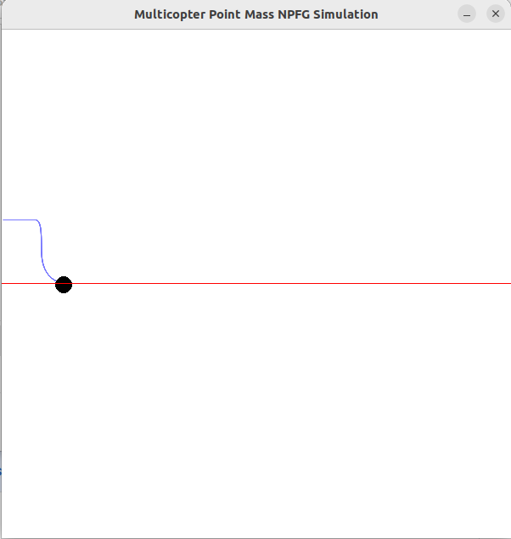
Track-keeping
User-set minimum ground speed = 5.0 m/s | User-set minimum ground speed = 0.0 m/s

Slide 6
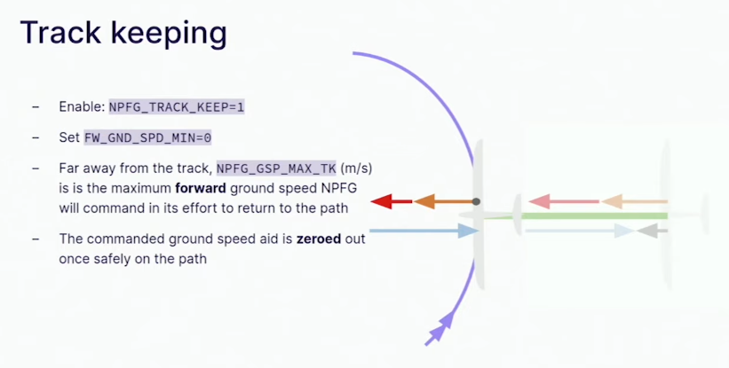
Limitations of NPFG Track-keeping feature

Slide 7
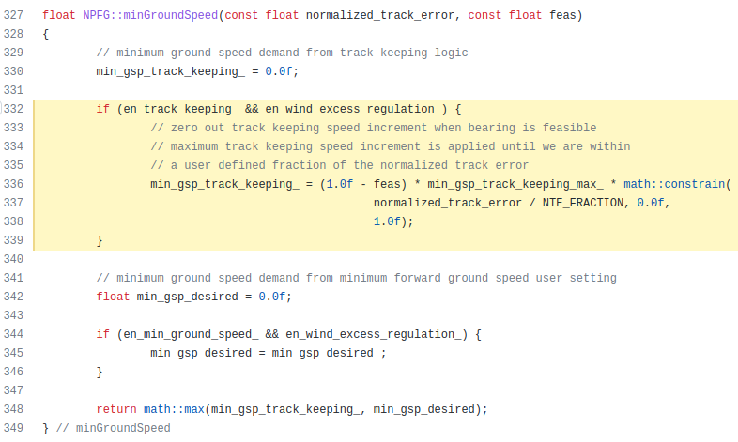
Limitations of NPFG Track-keeping feature

Slide 8
Bearing Feasibility
1 - feasibility
Minimum
Ground Speed
Track-Keeping
Minimum
Ground Speed
=
X

Slide 9
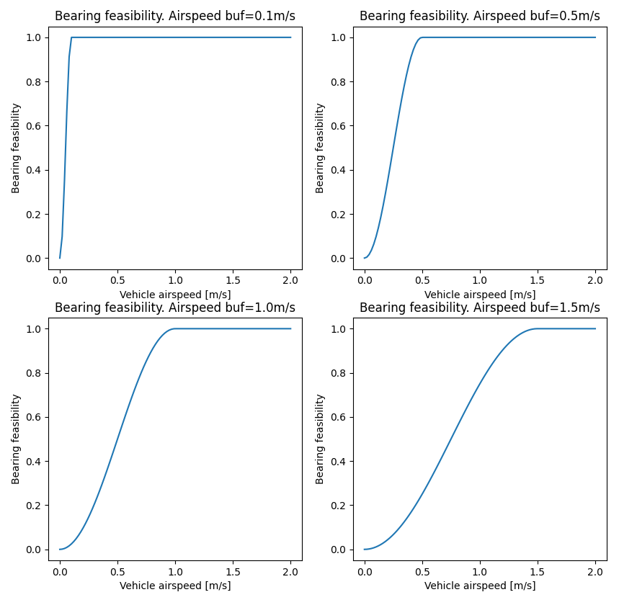
Bearing Feasibility
1 - feasibility
Minimum
Ground Speed
Track-Keeping
Minimum
Ground Speed
=
X

Slide 10
Bearing Feasibility

Slide 11
Bearing Feasibility

Slide 12
Bearing Feasibility

Slide 13
Bearing Feasibility

Slide 14
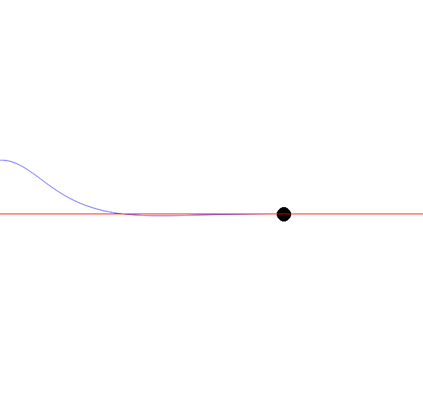
Multicopter vs Fixed-wing dynamics

